Slide 1
Welcome
Developing Technologies for
Smart Cities
By Pradeep Kothari

Slide 2
Developing Technologies
for Smart Cities
Presentation Topics
Do we need to develop technology for Smart cities?
We all hear the term "Smart Cities" .. What are they and How we can contribute to building Smart Cities?
Why :
Current technologies are expensive
e.g. 500 Crore for a 15 Km road.
Not built for Indian culture and environment.
Can’t be used in smaller cities and towns.
Huge Capex
ROI
Phone: +91 937 310 1776 | Email: project@smartcitytechnology.in
www.eBrandz.com

Slide 3
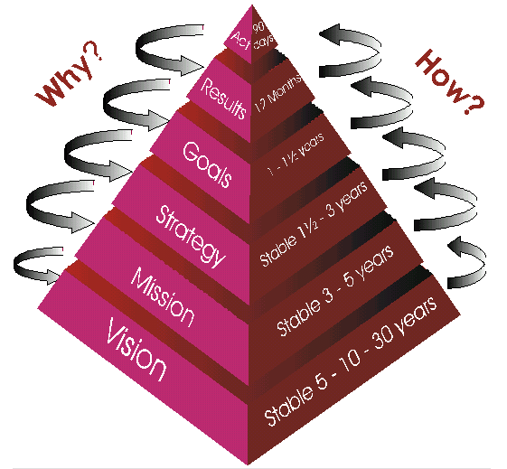
How do we get involved or develop technologies for smart cites?
What is Google?
Start Small.
Look around us, can we optimize, make our campus more efficient ?
Can we save energy? Water ? Environment?
Can we make our processes more efficient ( and save in the process?)
Phone: +91 937 310 1776 | Email: project@smartcitytechnology.in
www.eBrandz.com

Slide 4
Cosiderations when developing Technology
What is Google?
Stakeholder Expectations
Customers
Employees
Owners
WOTS-up
Weaknesses
Opportunities
Threats
Strengths
Trends
Other
Factors to consider when developing a new technology or solution.
Cost Involved
Gain from the development
ROI : Cost Vs. Savings
Detailed Thought Process
Integration with existing systems
Standardized protocols
Safety Features
Manual Override for emergencies
Data Security
Idiot proof
Phone: +91 937 310 1776 | Email: project@smartcitytechnology.in
www.eBrandz.com

Slide 5
Developing Technologies
for Smart Cities
Presentation Topics
Areas that can be worked on :
Select an area of interest :
Smart Home
Smart Office
Smart Campus
Energy Usage
Traffic
Water
Air Quality
Safety and security
Asset Tracking / GPS
Services
E-governance
Parking
Green Buildings
Agriculture
Industries
Phone: +91 937 310 1776 | Email: project@smartcitytechnology.in
www.eBrandz.com

Slide 6
Developing Technologies
for Smart Cities
Presentation Topics
Examples :
Smart Street Lights
1. Dawn / Dusk Sensor
2. Proximity ( PIR ) sensor
3. Half Power Time
4. Alternate or
5. 1 in 4 time
6. Wifi Connected
7. Master Controller
Vertical Garden
Hydroponics
Temperature
Moisture
Automated controls
Crop Intelligence
Phone: +91 937 310 1776 | Email: project@smartcitytechnology.in
www.eBrandz.com

Slide 7
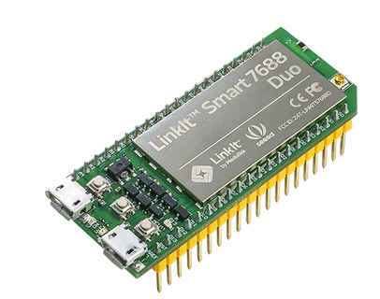
Developing Technologies
for Smart Cities
Presentation Topics
Project / IoT Platforms Available to work on :
Particle - Photon : $ 19
Tiny Wi-Fi development kit RF, USB for creating connected projects and (IoT)
Arduino $19
Integrated single-chipfor IoT ARM MCU, Wi-Fi
LinkIt One $59
-- ARM7EJ-S™,GSM, GPRS, Wi-Fi, Bluetooth BR/EDR/BLE, GPS, Audio codec, SD card connector
Intel Galelio
Raspberry Pi $49
1GHz, Single-core CPU 512MB RAM USB, 802.11Wifi , Bluetooth and BLE.
Beaglebone Series $44
AM3358 1GHz ARM® 512MB 4GB USB LAN
Software
Tools available from each of these and use “Arduino" compatible HL language
Phone: +91 937 310 1776 | Email: project@smartcitytechnology.in
www.eBrandz.com

Slide 8
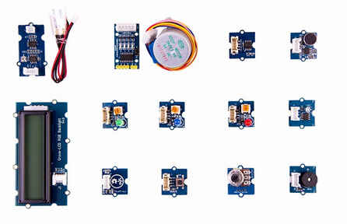
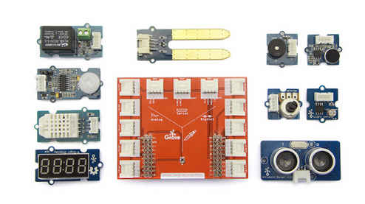
Developing Technologies
for Smart Cities
Presentation Topics
Sensors
LDR
Temperature Sensors
Motion, Gyro Sensors
Rotary Angle Sensors
IR sensors
PIR sensors
Barometer/Pressure Sensors
Humidity Sensor
Air Quality /Dust Sensors
Co2 Sensor
Ultra sound sensors
Speech Recognizer
Gesture Sensor
Touch Sensor
Phone: +91 937 310 1776 | Email: project@smartcitytechnology.in
www.eBrandz.com

Slide 9
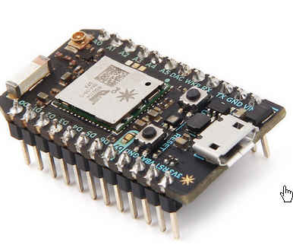
Developing Technologies
for Smart Cities
Presentation Topics
Project Guidelines available from
https://www.hackster.io/
https://www.seeedstudio.com/
https://www.particle.io/
https://labs.mediatek.com/en/platform/linkit-one
http://microbit.org/
Phone: +91 937 310 1776 | Email: project@smartcitytechnology.in
www.eBrandz.com

Slide 10
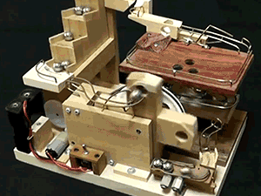
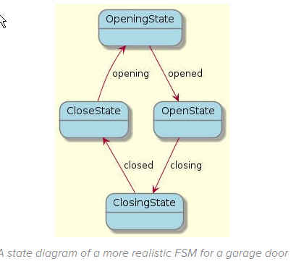
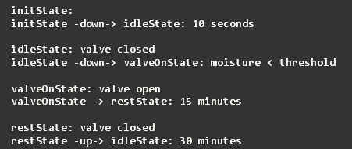
Sample projects
Presentation Topics
Phone: +91 937 310 1776 | Email: project@smartcitytechnology.in
www.eBrandz.com

Slide 11
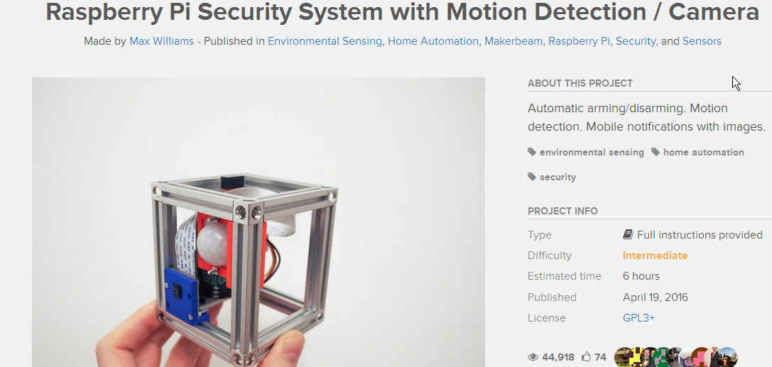
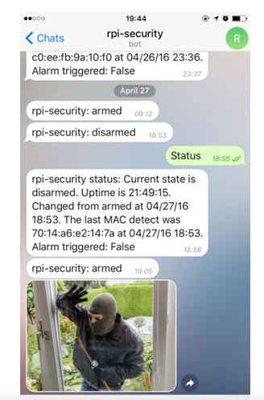
Sample Projects
Presentation Topics
Phone: +91 937 310 1776 | Email: project@smartcitytechnology.in
www.eBrandz.com

Slide 12
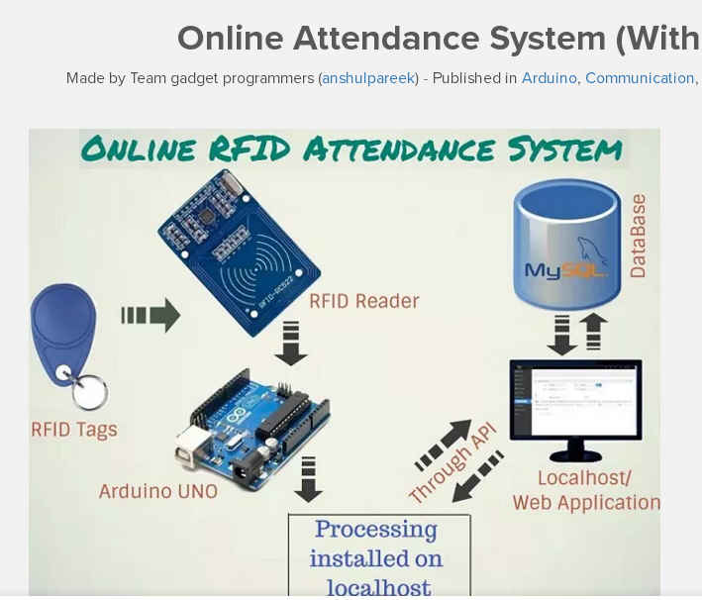
Sample Projects
Presentation Topics
Phone: +91 937 310 1776 | Email: project@smartcitytechnology.in
www.eBrandz.com

Slide 13
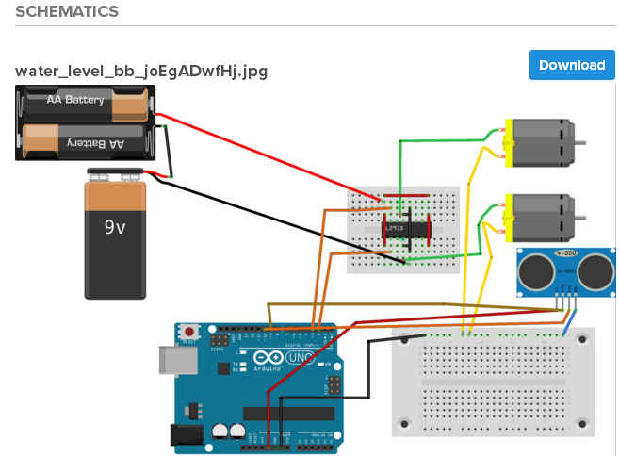
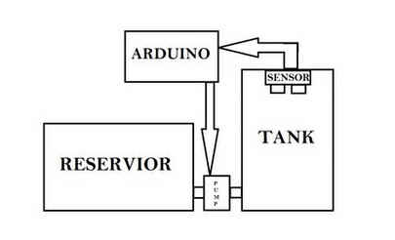
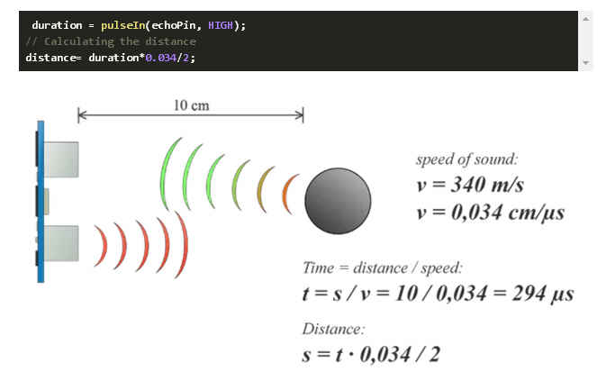
Sample Projects
Presentation Topics
Phone: +91 937 310 1776 | Email: project@smartcitytechnology.in
www.eBrandz.com

Slide 14
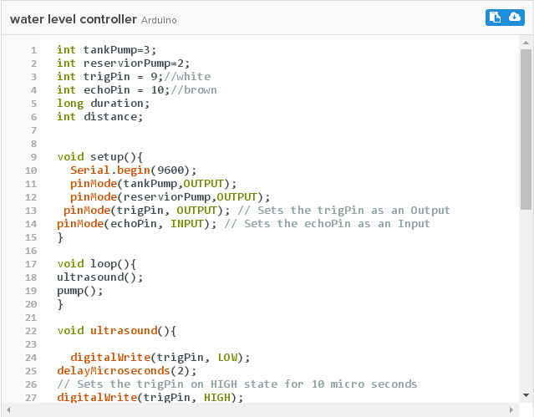
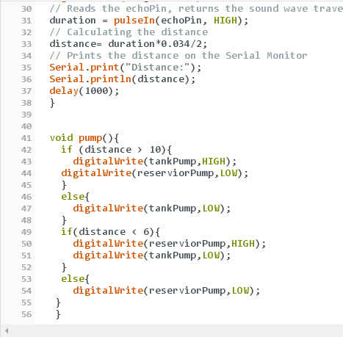
Sample Projects
Presentation Topics
Phone: +91 937 310 1776 | Email: project@smartcitytechnology.in
www.eBrandz.com

Slide 15
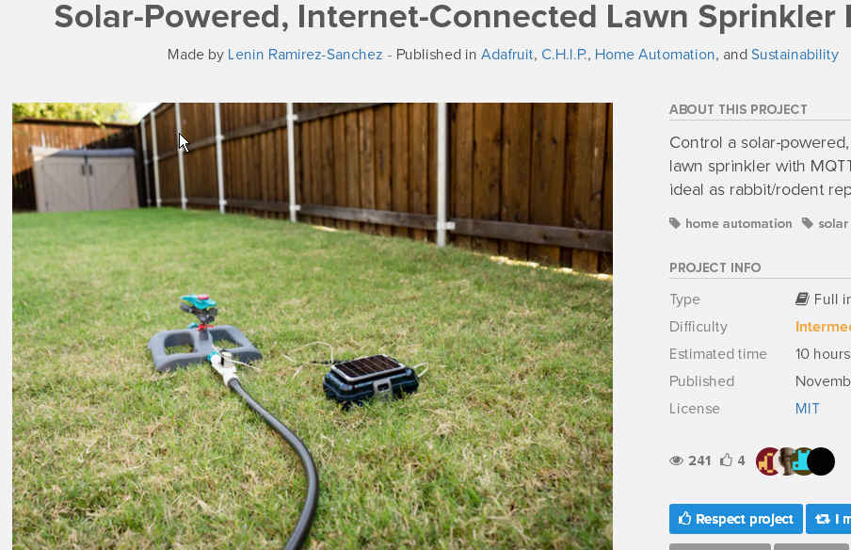
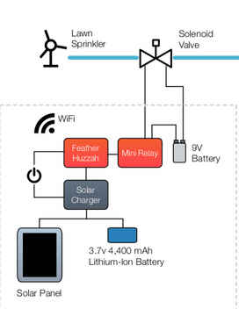
Sample Projects
Presentation Topics
Phone: +91 937 310 1776 | Email: project@smartcitytechnology.in
www.eBrandz.com

Slide 16
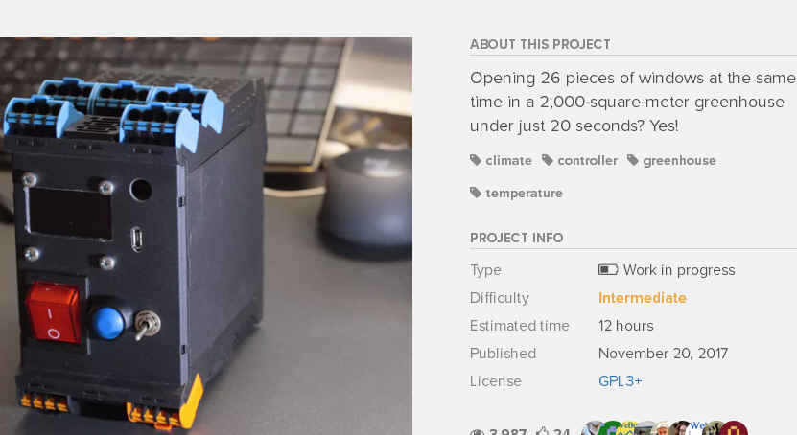
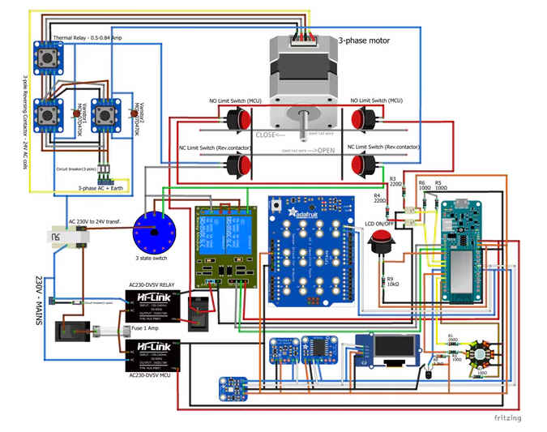
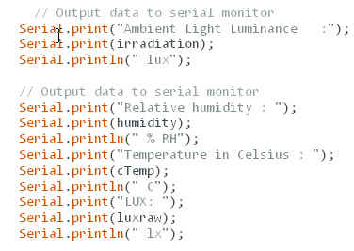
Sample Projects
Presentation Topics
Phone: +91 937 310 1776 | Email: project@smartcitytechnology.in
www.eBrandz.com

Slide 17
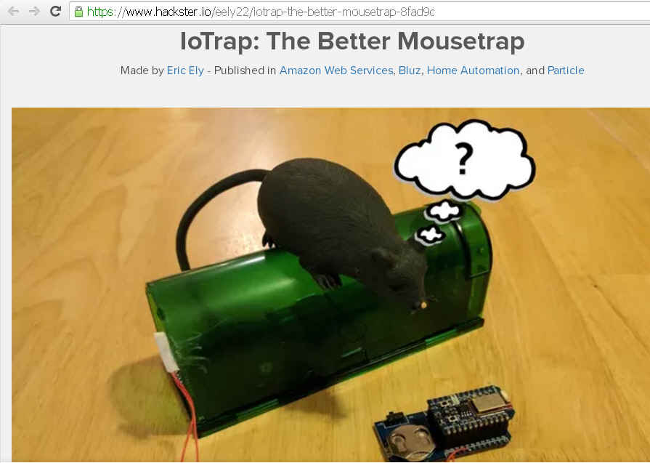
Developing Technologies
for Smart Cities
Presentation Topics
Sample Projects
Phone: +91 937 310 1776 | Email: project@smartcitytechnology.in
www.eBrandz.com

Slide 18
Thank you!
Phone: +91 937 310 1776 | Email: project@smartcitytechnology.in
www.eBrandz.com

